Slide 1
Chapter 2: Neuroscience of Memory

Slide 2
Introduction (1 of 4)
Brain vs. Mind?
Mind == control center of the brain?
Notes:
Different meanings of brain:
In everyday usage, brain and mind are almost synonymous.
Describing a person as a “brain” means their intelligence is their chief characteristic.
Biologically, the brain is responsible for thinking, memory, reasoning, and language through the neural structures maintained inside it.
Meaning of brain for neurosurgeons: A mass of soft tissue inside the head that must be handled very carefully when damaged.
Meaning of brain for cognitive neuroscientists:
A complex assortment of separate areas and regions, each of which has its own unique function.
These regions have their own appearance, microanatomy, set of connections to other areas, and function.
Biological functions of brain: Directly involved in memory, language, and thought.

Slide 3
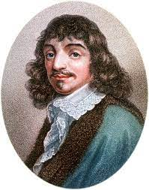
Introduction (2 of 4)
Are the mind and the brain separate?
Mind-Body problem (Rene Descartes)
  Two questions:
    Are mental items physical in nature?
    Is consciousness be explained in physical terms?

Slide 4
Introduction (3 of 4)
Most accepted contemporary view is that the mind/consciousness arises as a byproduct the brain
Changes to brain can alter the mind
  Changes in mood/perceptions from drug use
  Changes following physical damage or strokes

Slide 5
Introduction (4 of 4)
Meaning of brain for neurosurgeons.
  Mass of soft tissue which must be handled with care
Meaning of brain for cognitive neuroscientists.
  A complex assortment of separate areas
  Each has its own unique function
Biological functions of the brain.
  Directly involved in memory, language, and thought
Notes:
Meaning of brain for neurosurgeons: A mass of soft tissue inside the head that must be handled very carefully when damaged.
Meaning of brain for cognitive neuroscientists:
A complex assortment of separate areas and regions, each of which has its own unique function.
These regions have their own appearance, microanatomy, set of connections to other areas, and function.
Biological functions of brain: Directly involved in memory, language, and thought.

Slide 6
Old Questions, New Answers (1 of 4)
Where are memories stored?
  Deeply philosophical question!
  Knowing this would help neurosurgeons
Notes:
The question of memory storage:
A deeply philosophical question.
This knowledge would allow neuropsychologists to predict forms of amnesia.
During neurosurgery, these specific areas of storage need to be respected.
No specific storage location: Memories are distributed throughout the brain.
Search for the engram:
The hypothetical physical unit of storage of a memory.
Label was given by Karl Lashley who spent his entire career looking for these memory-specific cells but never found any.
He was forced to conclude that there are no engrams.
It is widely believed that stored memories have more to do with connections across spatially separate areas of the brain than any specific area.
Areas to support specific knowledge:
Quiroga et al. claimed to have found specific areas in the brain that support specific knowledge structures.
The Quiroga study has been criticized for being single-cell recording of volunteers who were about to have brain surgery.

Slide 7
Old Questions, New Answers (2 of 4)
Search for the engram.
  Engram = hypothetical physical unit of memory storage
Finding the engram == finding where specific memories are stored
Notes:
No specific storage location: Memories are distributed throughout the brain.
Search for the engram:
The hypothetical physical unit of storage of a memory.
Label was given by Karl Lashley who spent his entire career looking for these memory-specific cells but never found any.
He was forced to conclude that there are no engrams.
It is widely believed that stored memories have more to do with connections across spatially separate areas of the brain than any specific area.
Areas to support specific knowledge:
Quiroga et al. claimed to have found specific areas in the brain that support specific knowledge structures.
The Quiroga study has been criticized for being single-cell recording of volunteers who were about to have brain surgery.

Slide 8
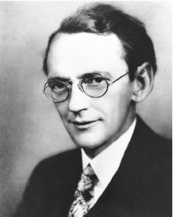
Old Questions, New Answers (3 of 4)
Karl Lashely (1890 – 1958): Devoted his career to finding the engram
Never found any…
Does the engram exist?
Notes:
Label was given by Karl Lashley who spent his entire career looking for these memory-specific cells but never found any.
He was forced to conclude that there are no engrams.
It is widely believed that stored memories have more to do with connections across spatially separate areas of the brain than any specific area.
Areas to support specific knowledge:
Quiroga et al. claimed to have found specific areas in the brain that support specific knowledge structures.
The Quiroga study has been criticized for being single-cell recording of volunteers who were about to have brain surgery.

Slide 9
Old Questions, New Answers (4 of 4)
Lack of engram suggests no specific storage location!
  Modern research suggests that memories are distributed throughout the brain
  Memory has more to do with spatial connections across separate brain regions
Notes:
No specific storage location: Memories are distributed throughout the brain.
Search for the engram:
The hypothetical physical unit of storage of a memory.
Label was given by Karl Lashley who spent his entire career looking for these memory-specific cells but never found any.
He was forced to conclude that there are no engrams.
It is widely believed that stored memories have more to do with connections across spatially separate areas of the brain than any specific area.
Areas to support specific knowledge:
Quiroga et al. claimed to have found specific areas in the brain that support specific knowledge structures.
The Quiroga study has been criticized for being single-cell recording of volunteers who were about to have brain surgery.

Slide 10
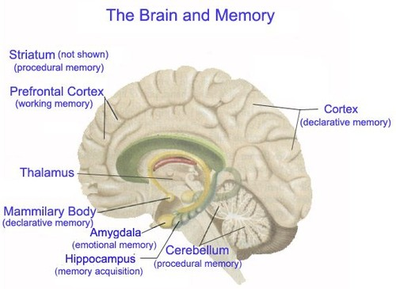

Slide 11
What is the link between the Brain and Memory?
How to test the brain/memory relationship?

Slide 12
Brain and Memory (1 of 16)
Alzheimer’s disease (AD).
Memory is the first deficit. Suggests that physical damage to the brain can impair memory
Notes:
Alzheimer’s disease:
One of many dementia-type illnesses that are more common in older adults than in younger adults.
Memory is the first deficit detected in this disease.
It is important to understand the neural processes of memory for medical research to be able to prevent or alleviate the symptoms of those with the disease.
Traumatic brain injuries:
Sudden and devastating injuries to the brain.
Memory deficits are also a common symptom of TBIs.
The largest source of TBIs is motor vehicle crashes.
Clinical neuropsychology:
The practice of helping brain-damaged patients recover and cope with their injuries.
The treatment and rehabilitation of TBIs is of tremendous social importance.
Other sources of memory-related brain damage: Strokes and tumors can create memory deficits.

Slide 13
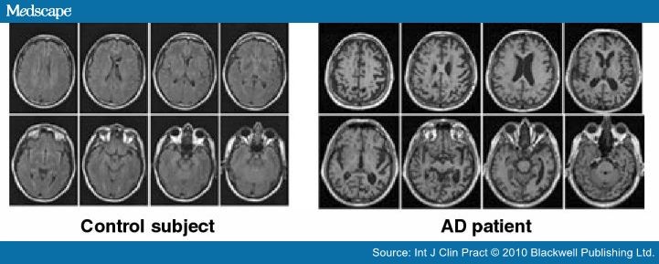
Characteristics of AD

Slide 14
Brain and Memory (2 of 16)
Traumatic brain injuries (TBIs).
  Sudden and devastating brain injuries
  Memory deficits are a common symptom (amnesia for events just prior/during the event)
  Largest cause of TBIs?
Notes:
Alzheimer’s disease:
One of many dementia-type illnesses that are more common in older adults than in younger adults.
Memory is the first deficit detected in this disease.
It is important to understand the neural processes of memory for medical research to be able to prevent or alleviate the symptoms of those with the disease.
Traumatic brain injuries:
Sudden and devastating injuries to the brain.
Memory deficits are also a common symptom of TBIs.
The largest source of TBIs is motor vehicle crashes.
Clinical neuropsychology:
The practice of helping brain-damaged patients recover and cope with their injuries.
The treatment and rehabilitation of TBIs is of tremendous social importance.
Other sources of memory-related brain damage: Strokes and tumors can create memory deficits.

Slide 15
Brain and Memory (3 of 16)
Other sources of memory-related brain damage.
  Strokes
  Tumors
  Lesions
Notes:
Alzheimer’s disease:
One of many dementia-type illnesses that are more common in older adults than in younger adults.
Memory is the first deficit detected in this disease.
It is important to understand the neural processes of memory for medical research to be able to prevent or alleviate the symptoms of those with the disease.
Traumatic brain injuries:
Sudden and devastating injuries to the brain.
Memory deficits are also a common symptom of TBIs.
The largest source of TBIs is motor vehicle crashes.
Clinical neuropsychology:
The practice of helping brain-damaged patients recover and cope with their injuries.
The treatment and rehabilitation of TBIs is of tremendous social importance.
Other sources of memory-related brain damage: Strokes and tumors can create memory deficits.

Slide 16
Lesions (1 of 3)
General term for damage to the physical structure of the brain

Slide 17
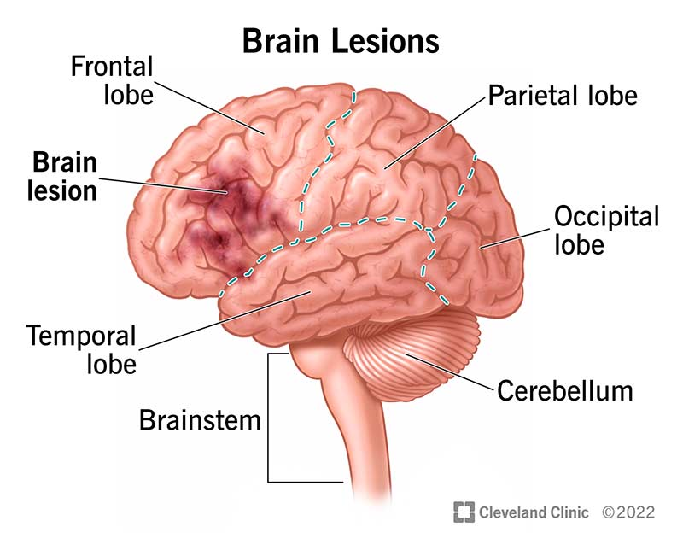

Slide 18
Lesions (2 of 3)
Two types:
  Damage from injury/illness
  Surgical lesions
Why surgical lesions?

Slide 19
Lesions (3 of 3)
Neurosurgery
  Lengthy history dating to ancient times
    Incas: Trepanation
  Modern:
    Tumor removal (first successful in 1884)
    Lobotomies (1940s – 1950’s -- highly controversial)
    Implanting electrodes in brain (1950) → Cohlear implants (1972)
  How can neurosurgery be used to learn about brain functions?
  Ethical implications?

Slide 20
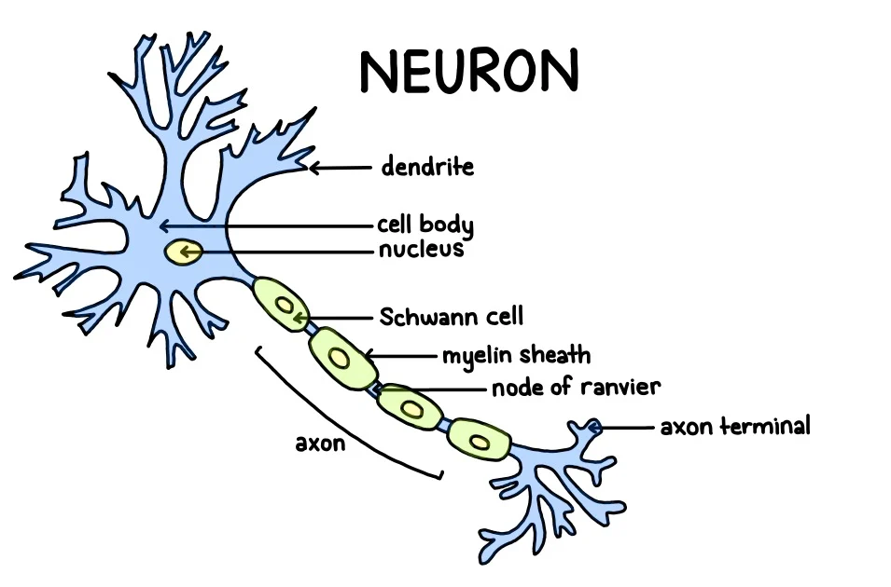
Brain and Memory (4 of 16)
Action potential: Neuron fires when activation reaches threshold
Activation flows dendrites to axon
Notes:
Satisfies Learning Objective 1: Explain what a neuron is and how it functions.
Definition of neurons:
They are biological cells that specialize in the transmission and retention of information.
Basic building blocks of the nervous system.
Fundamental understanding of neurons is required for understanding memory or any other cognitive process.
Parts of the neuron:
A nucleus, which contains one set of the individual’s chromosomes.
The chromosomes contain the genes that house the individual’s DNA.
The soma or cell body surrounds the nucleus.
The soma contains the mitochondria and other organelles.
Neurons have two unique types of fibers that allow the transmission of information from one part of the brain or nervous system to another part.
One type of fibers leads into the neurons.
The second type leads out of the neurons.
Dendrite: The parts of the neuron that receive information from other neurons or directly from sensory receptors.
Axon and action potential:
Axon: The part of the neuron that sends information to other neurons.
Action potential: The electrochemical process of transmission in an axon.

Slide 21
Brain and Memory (5 of 16)
Neurotransmitters: Chemical messengers produced by nervous system.
Serve many functions! Depends on neuron, brain region, etc.
Notes:
Satisfies Learning Objective 1: Explain what a neuron is and how it functions.
Proteins produced by nervous system: Different neurotransmitters serve different functions, depending on the type of neuron and the part of the brain.
Classification of neurotransmitters:
The fundamental criterion for this classification is that the chemical must bridge the synapse and induce an electric current in a dendrite.
Neurotransmitters that increase activity in the neuron are said to be excitatory.
Neurotransmitters that decrease activity in the neuron are said to be inhibitory.
Common neurotransmitters: Dopamine, acetylcholine, serotonin, gamma-aminobutyric acid (GABA), and norepinephrine.
Effects of malfunctions in chemical production:
Malfunctions of the systems that produce these chemicals may cause neurological disorders.
For example, in Parkinson’s disease, a part of the brain (the substantia nigra) is no longer able to produce enough dopamine, resulting in the characteristic movement disorders of the disease.
Substantia nigra: A part of the brain that produces dopamine.
Sometimes, the process of production of neurotransmitters is altered in order to treat psychiatric conditions.
Orally consumed drugs can alter the functioning of many of these neurotransmitters.
For example, cocaine blocks the flow of dopamine.
Nicotine, the main active drug in tobacco products, increases the activation of the neurons that innervate our muscles.

Slide 22
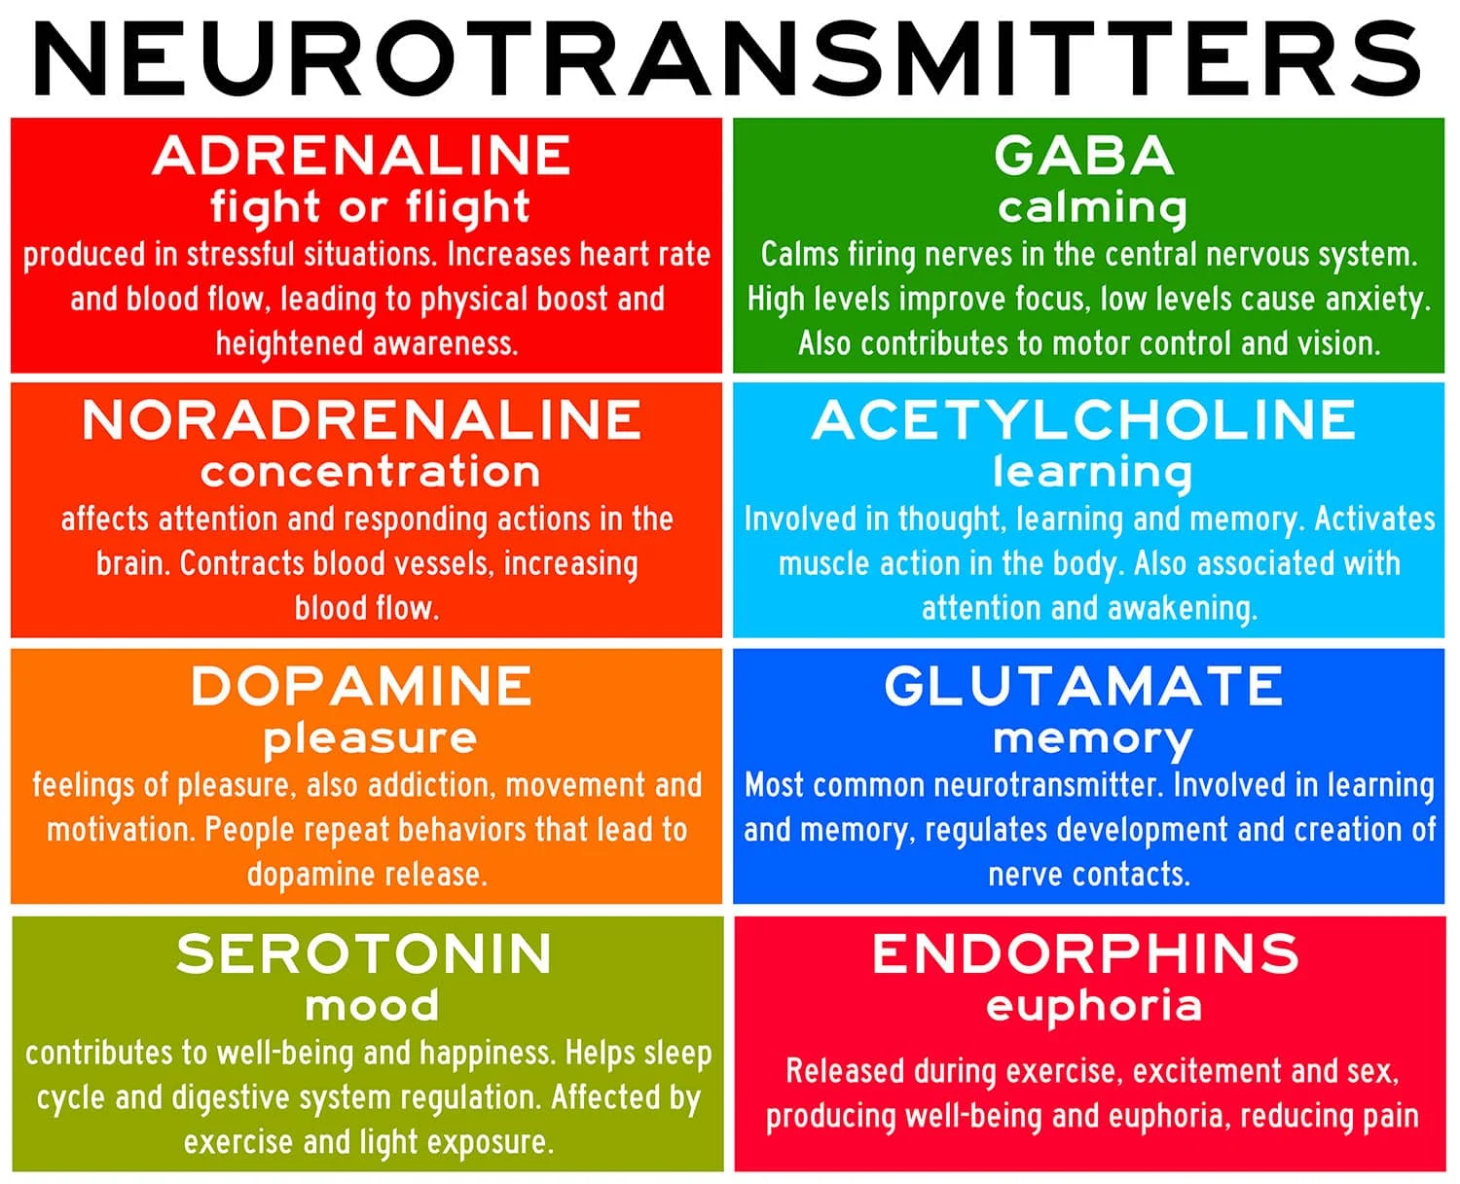
Notes:
Satisfies Learning Objective 1: Explain what a neuron is and how it functions.
Proteins produced by nervous system: Different neurotransmitters serve different functions, depending on the type of neuron and the part of the brain.
Classification of neurotransmitters:
The fundamental criterion for this classification is that the chemical must bridge the synapse and induce an electric current in a dendrite.
Neurotransmitters that increase activity in the neuron are said to be excitatory.
Neurotransmitters that decrease activity in the neuron are said to be inhibitory.
Common neurotransmitters: Dopamine, acetylcholine, serotonin, gamma-aminobutyric acid (GABA), and norepinephrine.
Effects of malfunctions in chemical production:
Malfunctions of the systems that produce these chemicals may cause neurological disorders.
For example, in Parkinson’s disease, a part of the brain (the substantia nigra) is no longer able to produce enough dopamine, resulting in the characteristic movement disorders of the disease.
Substantia nigra: A part of the brain that produces dopamine.
Sometimes, the process of production of neurotransmitters is altered in order to treat psychiatric conditions.
Orally consumed drugs can alter the functioning of many of these neurotransmitters.
For example, cocaine blocks the flow of dopamine.
Nicotine, the main active drug in tobacco products, increases the activation of the neurons that innervate our muscles.

Slide 23
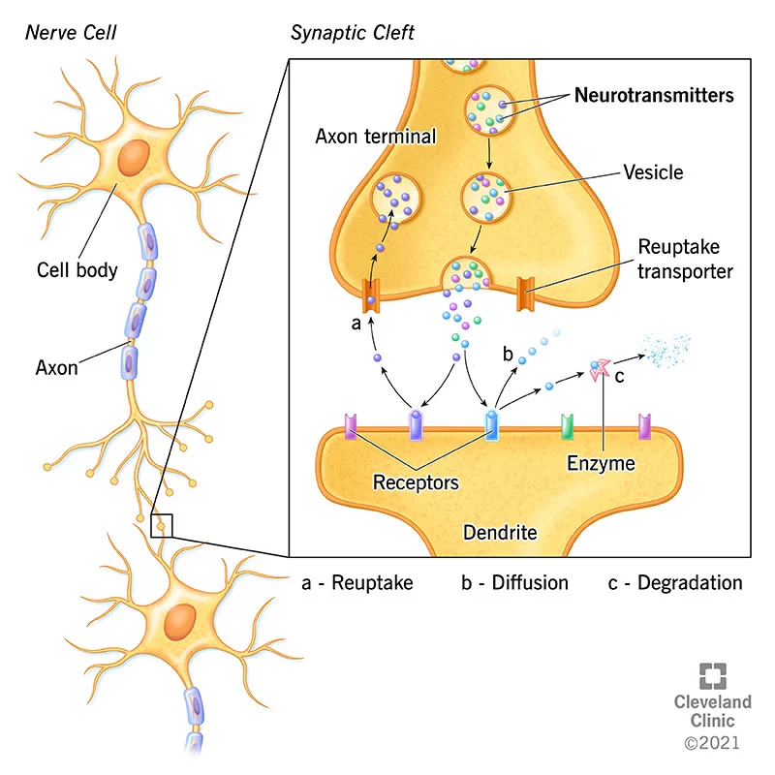
Notes:
Satisfies Learning Objective 1: Explain what a neuron is and how it functions.
Proteins produced by nervous system: Different neurotransmitters serve different functions, depending on the type of neuron and the part of the brain.
Classification of neurotransmitters:
The fundamental criterion for this classification is that the chemical must bridge the synapse and induce an electric current in a dendrite.
Neurotransmitters that increase activity in the neuron are said to be excitatory.
Neurotransmitters that decrease activity in the neuron are said to be inhibitory.
Common neurotransmitters: Dopamine, acetylcholine, serotonin, gamma-aminobutyric acid (GABA), and norepinephrine.
Effects of malfunctions in chemical production:
Malfunctions of the systems that produce these chemicals may cause neurological disorders.
For example, in Parkinson’s disease, a part of the brain (the substantia nigra) is no longer able to produce enough dopamine, resulting in the characteristic movement disorders of the disease.
Substantia nigra: A part of the brain that produces dopamine.
Sometimes, the process of production of neurotransmitters is altered in order to treat psychiatric conditions.
Orally consumed drugs can alter the functioning of many of these neurotransmitters.
For example, cocaine blocks the flow of dopamine.
Nicotine, the main active drug in tobacco products, increases the activation of the neurons that innervate our muscles.

Slide 24
Brain and Memory (6 of 16)
The human brain is highly complex
Contains over 100 billion neurons (larger than all other primates)
Energy intensive: Accounts for ~25% of body’s oxygen use
Separate anatomical areas (e.g. Lobes, hemispheres)
Notes:
Satisfies Learning Objective 2: Describe the anatomy of the brain with respect to memory including cortical and non-cortical areas.
A complex biological organ:
It contains more than 100 billion neurons and their supporting cells.
The human brain is larger than all other primate brains.
It is an energy-intensive organ, accounting for about 25% of the body’s oxygen use at any given moment.
It has separate anatomical and functional areas.
Hemispheres of the brain:
Right hemisphere/left hemisphere: The brain is divisible into two symmetrical halves, oriented in the left-right direction.
The left hemisphere is focused on language and memory, the interaction between the two.
The right hemisphere is involved in spatial cognition.
There are many overlaps between the two hemispheres in function, making the popular distinction between “left-brained people” and “right-brained people” redundant.
Cortical and subcortical structures: The brain is vertically divided into cortical (surface of the brain) and subcortical (below the surface) structures.
Cerebral cortex:
The outer layer of the brain most associated with higher cognitive and emotional functioning.
It is this part that distinguishes our brains from those of other species.

Slide 25
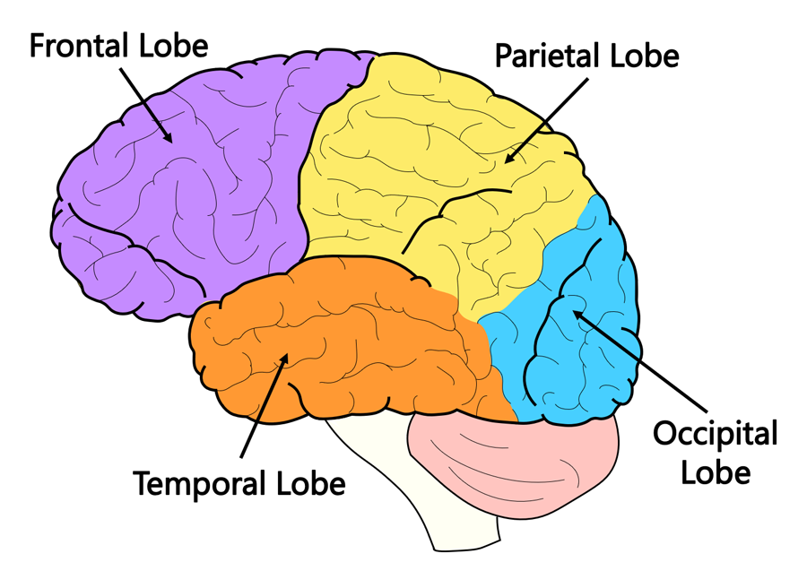
Brain and Memory (5 of x)
Notes:
Satisfies Learning Objective 2: Describe the anatomy of the brain with respect to memory including cortical and non-cortical areas.
A complex biological organ:
It contains more than 100 billion neurons and their supporting cells.
The human brain is larger than all other primate brains.
It is an energy-intensive organ, accounting for about 25% of the body’s oxygen use at any given moment.
It has separate anatomical and functional areas.
Hemispheres of the brain:
Right hemisphere/left hemisphere: The brain is divisible into two symmetrical halves, oriented in the left-right direction.
The left hemisphere is focused on language and memory, the interaction between the two.
The right hemisphere is involved in spatial cognition.
There are many overlaps between the two hemispheres in function, making the popular distinction between “left-brained people” and “right-brained people” redundant.
Cortical and subcortical structures: The brain is vertically divided into cortical (surface of the brain) and subcortical (below the surface) structures.
Cerebral cortex:
The outer layer of the brain most associated with higher cognitive and emotional functioning.
It is this part that distinguishes our brains from those of other species.

Slide 26
Brain and Memory (7 of 16)
Lobes and Memory
Parietal lobe: Somatosensory perception.
Occipital lobe: Visual processing.
Frontal lobe: Decision making.
Temporal lobe: Learning and audition.
Notes:
Satisfies Learning Objective 2: Describe the anatomy of the brain with respect to memory including cortical and non-cortical areas.
Parietal lobe:
Somatosensory perception:
Refers to our various senses of touch.
Located toward the front of the parietal lobe.
Attention:
Located toward the back of the parietal lobe.
These are networks engaged in spatial attention (in the right hemisphere) and verbal material (in the left hemisphere).
Activity in the parietal lobe is critical to working and prospective memory tasks.
Occipital lobe:
Responsible for visual processing.
It provides visual imagery for people to remember events.
The V4 area in this lobe is responsible for color processing.
Frontal lobe:
The most anterior part of the cerebral cortex.
It is associated with higher emotions, decision-making, metacognition, and memory.
Prefrontal cortex (prefrontal area): The part of the frontal lobe most associated with higher emotions (e.g., jealousy, respect) and memory.
Temporal lobe:
A part of the cerebral cortex associated with learning, memory, audition, and language.
Medial temporal lobe:
Area of the temporal lobes associated with learning and memory.
Damage can cause anterograde amnesia.

Slide 27
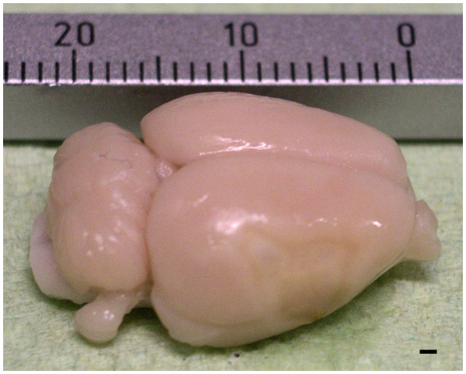
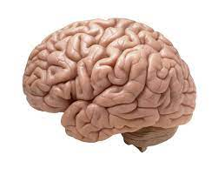
Brain and Memory (8 of 16)
Rat Brain
Human Brain
Cerebral Cortex: Outer layer of the brain; associated w/ higher order cognition and emotional functioning
Distinguishes humans from other species!
Notes:
Satisfies Learning Objective 2: Describe the anatomy of the brain with respect to memory including cortical and non-cortical areas.
A complex biological organ:
It contains more than 100 billion neurons and their supporting cells.
The human brain is larger than all other primate brains.
It is an energy-intensive organ, accounting for about 25% of the body’s oxygen use at any given moment.
It has separate anatomical and functional areas.
Hemispheres of the brain:
Right hemisphere/left hemisphere: The brain is divisible into two symmetrical halves, oriented in the left-right direction.
The left hemisphere is focused on language and memory, the interaction between the two.
The right hemisphere is involved in spatial cognition.
There are many overlaps between the two hemispheres in function, making the popular distinction between “left-brained people” and “right-brained people” redundant.
Cortical and subcortical structures: The brain is vertically divided into cortical (surface of the brain) and subcortical (below the surface) structures.
Cerebral cortex:
The outer layer of the brain most associated with higher cognitive and emotional functioning.
It is this part that distinguishes our brains from those of other species.

Slide 28
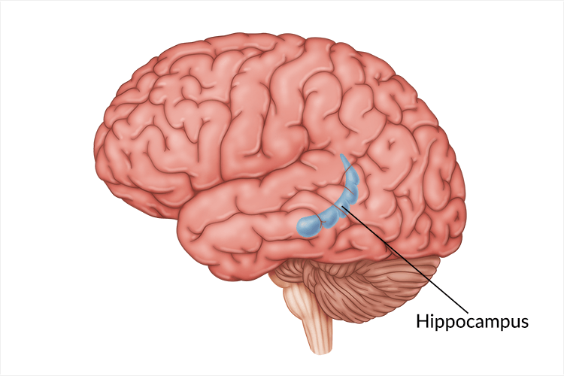
Brain and Memory (9 of 16)
Subcortical Structures related to memory
Hippocampus: Learning and memory.
Incredibly important for long-term memory
Notes:
Satisfies Learning Objective 2: Describe the anatomy of the brain with respect to memory including cortical and non-cortical areas.
Hippocampus:
It is an area of the brain associated with learning and memory; damage can cause anterograde amnesia.
Limbic system: Set of brain structures located just beneath the cerebral cortex that includes the hypothalamus, the hippocampus, and the amygdala and functions as an important area for both memory and emotion.
Damage to the hippocampus can cause amnesia.
Amnesia: Memory deficits acquired through brain damage.
Some research indicates that the left hippocampus is responsible for verbal memory, whereas the right hippocampus is responsible for memory of the spatial world around us.
Amygdala:
A part of the brain critical in emotional learning, fear, and memory.
Hypothalamus: An area of the brain associated with basic emotions.
The amygdala is associated with both fear conditioning and emotional learning.
Diencephalon:
The part of the brain that includes the thalamus and hypothalamus.
It serves as an important relay point in human memory circuits.
Thalamus: An area of the brain heavily connected to other areas of the brain; it appears to serve as a routing center, connecting disparate parts of the brain.
The amnesic syndrome known as Korsakoff’s disease, which involves deficits in new learning, retrieving well-stored information, and an inability to distinguish between true and false memories, is associated with damage to the diencephalon.

Slide 29
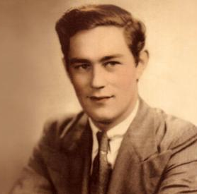
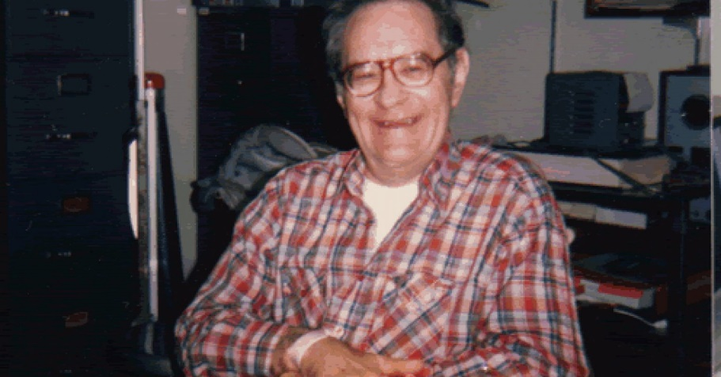
Patient HM (1 of 3)
Henry Molaison (1926 - 2008)
Suffered from severe epilepsy in childhood
Age of 27, had experimental neurosurgery to remove both hippocampi
Notes:
Satisfies Learning Objective 4: Assess the role of neuropsychology in understanding the neuroscience of memory.
The case of Phineas Gage:
Phineas Gage was a survivor of an accident that left him with a brain injury, altering his cognitive and emotional abilities, as well as his personality.
The study of the change in his behavior set the stage for the development of neuropsychology.
Research goal of neuropsychology: Correlating behavioral deficits or cognitive changes with the area of the brain that is damaged.
Anterograde amnesia and retrograde amnesia:
Anterograde amnesia: An inability to form new memories following brain damage.
Retrograde amnesia: An inability to retrieve memories of events prior to brain damage.
Relation of deficits in cognition and behavior: Neuropsychologists examine these relations with the locus of damage within the person’s brain.

Slide 30
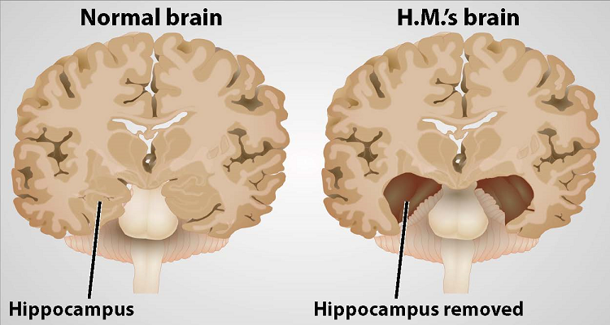
Patient HM (2 of 3)

Slide 31
Patient HM (3 of 3)
How was HM’s memory affected by the surgery?
Notes:
Satisfies Learning Objective 4: Assess the role of neuropsychology in understanding the neuroscience of memory.
The case of Phineas Gage:
Phineas Gage was a survivor of an accident that left him with a brain injury, altering his cognitive and emotional abilities, as well as his personality.
The study of the change in his behavior set the stage for the development of neuropsychology.
Research goal of neuropsychology: Correlating behavioral deficits or cognitive changes with the area of the brain that is damaged.
Anterograde amnesia and retrograde amnesia:
Anterograde amnesia: An inability to form new memories following brain damage.
Retrograde amnesia: An inability to retrieve memories of events prior to brain damage.
Relation of deficits in cognition and behavior: Neuropsychologists examine these relations with the locus of damage within the person’s brain.

Slide 32
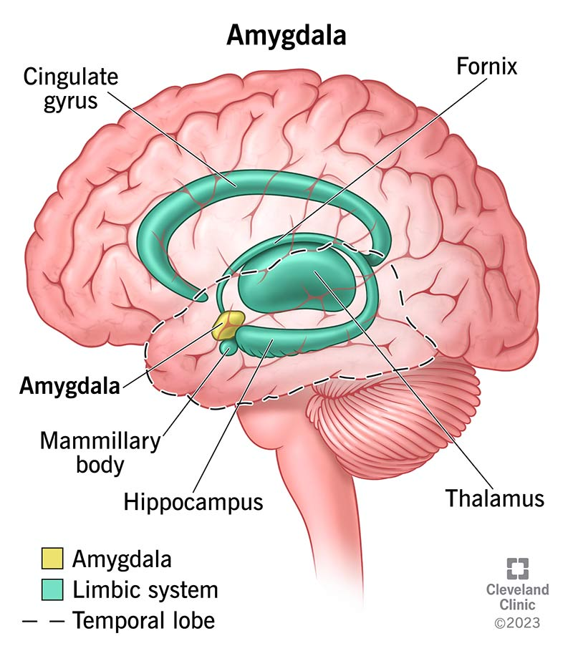
Brain and Memory (10 of 16)
Subcortical Structures related to memory
Amygdala: Emotional learning and fear.
Part of the limbic system
Notes:
Limbic system controls behavioral and emotional responses

Slide 33
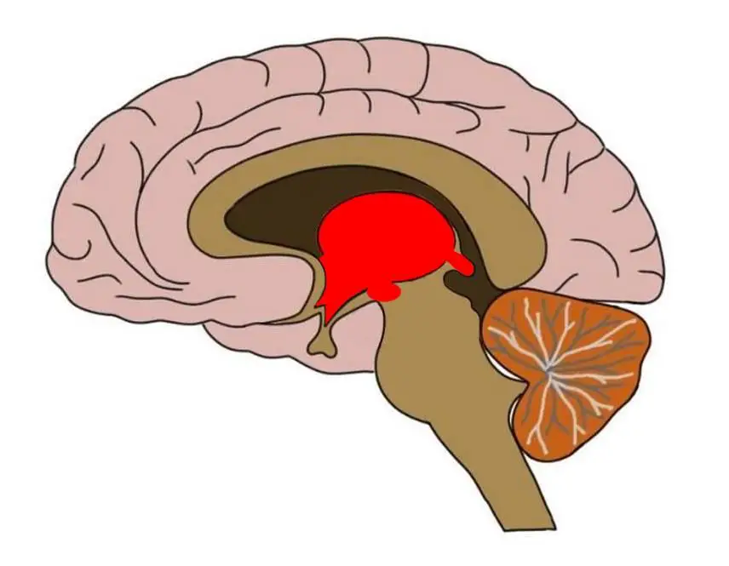
Brain and Memory (11 of 16)
Subcortical Structures related to memory
Diencephalon: Routing center.
Helps coordinate exchange of information between brain regions
Notes:
Satisfies Learning Objective 2: Describe the anatomy of the brain with respect to memory including cortical and non-cortical areas.
Hippocampus:
It is an area of the brain associated with learning and memory; damage can cause anterograde amnesia.
Limbic system: Set of brain structures located just beneath the cerebral cortex that includes the hypothalamus, the hippocampus, and the amygdala and functions as an important area for both memory and emotion.
Damage to the hippocampus can cause amnesia.
Amnesia: Memory deficits acquired through brain damage.
Some research indicates that the left hippocampus is responsible for verbal memory, whereas the right hippocampus is responsible for memory of the spatial world around us.
Amygdala:
A part of the brain critical in emotional learning, fear, and memory.
Hypothalamus: An area of the brain associated with basic emotions.
The amygdala is associated with both fear conditioning and emotional learning.
Diencephalon:
The part of the brain that includes the thalamus and hypothalamus.
It serves as an important relay point in human memory circuits.
Thalamus: An area of the brain heavily connected to other areas of the brain; it appears to serve as a routing center, connecting disparate parts of the brain.
The amnesic syndrome known as Korsakoff’s disease, which involves deficits in new learning, retrieving well-stored information, and an inability to distinguish between true and false memories, is associated with damage to the diencephalon.

Slide 34
Diencephalon and Memory
Case of patient B. J.
  Developed severe memory impairment after a pool cue entered his left nostril and pierced the basal region of his brain (diencephalon is located in this region)
  No damage to the hippocampus or amygdala!
Notes:
Satisfies Learning Objective 2: Describe the anatomy of the brain with respect to memory including cortical and non-cortical areas.
Hippocampus:
It is an area of the brain associated with learning and memory; damage can cause anterograde amnesia.
Limbic system: Set of brain structures located just beneath the cerebral cortex that includes the hypothalamus, the hippocampus, and the amygdala and functions as an important area for both memory and emotion.
Damage to the hippocampus can cause amnesia.
Amnesia: Memory deficits acquired through brain damage.
Some research indicates that the left hippocampus is responsible for verbal memory, whereas the right hippocampus is responsible for memory of the spatial world around us.
Amygdala:
A part of the brain critical in emotional learning, fear, and memory.
Hypothalamus: An area of the brain associated with basic emotions.
The amygdala is associated with both fear conditioning and emotional learning.
Diencephalon:
The part of the brain that includes the thalamus and hypothalamus.
It serves as an important relay point in human memory circuits.
Thalamus: An area of the brain heavily connected to other areas of the brain; it appears to serve as a routing center, connecting disparate parts of the brain.
The amnesic syndrome known as Korsakoff’s disease, which involves deficits in new learning, retrieving well-stored information, and an inability to distinguish between true and false memories, is associated with damage to the diencephalon.

Slide 35
Brain and Memory (12 of 16)
Methods of Cognitive Neuroscience
Learning and remembering are biological processes of the brain.
How to study?
Neuroimaging!
  Makes detailed maps of the brain
  Seeks to determine which regions of the brain are responsible for different functions
Notes:
Satisfies Learning Objective 3: Interpret the methodologies used in understanding the cognitive neuroscience of memory.
Biological processes of the brain: Learning and remembering are biological processes based in the brain.
Neuroimaging: A set of techniques that allow researchers to make detailed maps of the human brain and assign functions to particular regions in the brain.

Slide 36
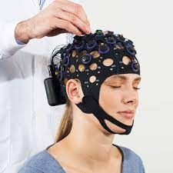
Brain and Memory (13 of 16)
EEG (Electroencephalography)
Uses electrodes to measure the electrical output of the brain by recording electric current at the scalp.
Intracranial EEG: electrodes placed on the surface of brain
Event-related potential: Average pattern of activity across many trials
Key Question: Does activity spike under certain conditions?
Notes:
Satisfies Learning Objective 3: Interpret the methodologies used in understanding the cognitive neuroscience of memory.
EEG (electroencephalography):
Using electrodes to measure the electrical output of the brain by recording electric current at the scalp.
Also known as scalp EEG.
Oldest neuroimaging technique.
Intracranial EEG: Measuring brain activity when electrodes are placed directly on the surface of the brain.
Event-related potential:
The averaged EEG pattern across many trials of EEG recordings in response to a particular class of stimulus.
ERP can be used to probe the time course of cognitive processes in the brain.

Slide 37
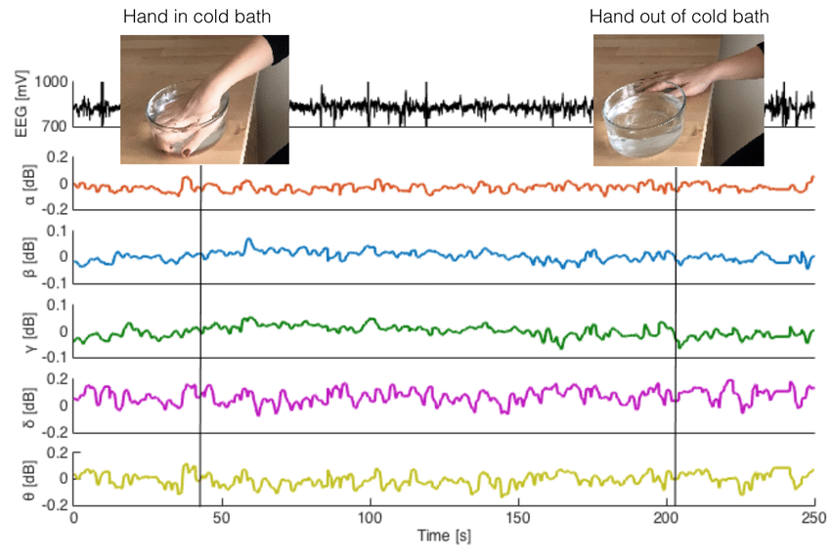
EEG Output
Notes:
Satisfies Learning Objective 3: Interpret the methodologies used in understanding the cognitive neuroscience of memory.
EEG (electroencephalography):
Using electrodes to measure the electrical output of the brain by recording electric current at the scalp.
Also known as scalp EEG.
Oldest neuroimaging technique.
Intracranial EEG: Measuring brain activity when electrodes are placed directly on the surface of the brain.
Event-related potential:
The averaged EEG pattern across many trials of EEG recordings in response to a particular class of stimulus.
ERP can be used to probe the time course of cognitive processes in the brain.

Slide 38
Brain and Memory (14 of 16)
Positron Emission Tomography (PET)
Provides detailed images of a living brain w/out tissue damage
Shows changes in blood flow to the brain
Small radioactive tracers are injected into the blood.
  Pet scan tracks these tracers as they move throughout the body
Notes:
Satisfies Learning Objective 3: Interpret the methodologies used in understanding the cognitive neuroscience of memory.
Purpose of PET:
Used by scientists to get a detailed image of a living human brain without having to damage any living tissue.
Useful for both medical and research purposes.
Operating principle:
Areas of the brain that are being used require more blood.
By tracing the path of the blood during a memory or cognitive task to a particular area of the brain, the latter’s cognitive function can be deduced.
The process:
A small amount of radioactive tracer is injected into the blood, which travels to all parts of the body and brain.
PET scans determine which areas of the brain are more radioactive, thereby associating it with the cognitive task the volunteer is engaging in.

Slide 39
Brain and Memory (15 of 16)
Magnetic Resonance Imaging Technologies
fMRI: Provides detailed mapping of the brain
Can show changes in activation by comparing movement of water molecules within tissue
  Changes in blood flow in the brain!
  Link between blood flow and brain activation?
Notes:
Satisfies Learning Objective 3: Interpret the methodologies used in understanding the cognitive neuroscience of memory.
fMRI and MRI:
Functional magnetic resonance imaging (fMRI) combine MRI methods to allow detailed spatial mapping, excellent temporal resolution, as well as the ability to look at white matter and gray matter.
Standard magnetic resonance imaging (MRI) is a medical tool commonly used to examine structural damage in internal organs, and it is routinely used to detect tumors, growths, and other damage in the brain.
Diffusion tensor imaging (DTI):
Compares the pattern of movement of molecules, particularly water, within tissue in order to derive structural images.
It is particularly useful for examining white-matter connections and delineating pathways in the brain rather than neural centers.
MRI-based research:
Koshino et al. explored the differences in working or short-term memory for faces in individuals with autism using fMRI.
Their research concluded that the neuroimaging data support the lower levels of activation in areas of the left prefrontal lobe, known to be involved in working memory.

Slide 40
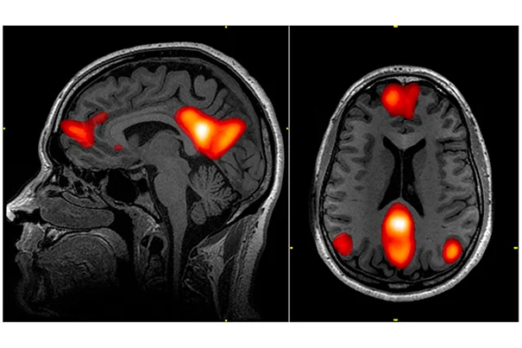
fMRI Scans
Notes:
Satisfies Learning Objective 3: Interpret the methodologies used in understanding the cognitive neuroscience of memory.
fMRI and MRI:
Functional magnetic resonance imaging (fMRI) combine MRI methods to allow detailed spatial mapping, excellent temporal resolution, as well as the ability to look at white matter and gray matter.
Standard magnetic resonance imaging (MRI) is a medical tool commonly used to examine structural damage in internal organs, and it is routinely used to detect tumors, growths, and other damage in the brain.
Diffusion tensor imaging (DTI):
Compares the pattern of movement of molecules, particularly water, within tissue in order to derive structural images.
It is particularly useful for examining white-matter connections and delineating pathways in the brain rather than neural centers.
MRI-based research:
Koshino et al. explored the differences in working or short-term memory for faces in individuals with autism using fMRI.
Their research concluded that the neuroimaging data support the lower levels of activation in areas of the left prefrontal lobe, known to be involved in working memory.

Slide 41
Brain and Memory (16 of 16)
Early Neuropsychology
The case of Phineas Gage.
Changes in physical structure of the brain and behavior (lesion studies)
Anterograde and retrograde amnesia.
  Inability to form new memories vs. loss of previous memory
  Case of patient HM
Notes:
Satisfies Learning Objective 4: Assess the role of neuropsychology in understanding the neuroscience of memory.
The case of Phineas Gage:
Phineas Gage was a survivor of an accident that left him with a brain injury, altering his cognitive and emotional abilities, as well as his personality.
The study of the change in his behavior set the stage for the development of neuropsychology.
Research goal of neuropsychology: Correlating behavioral deficits or cognitive changes with the area of the brain that is damaged.
Anterograde amnesia and retrograde amnesia:
Anterograde amnesia: An inability to form new memories following brain damage.
Retrograde amnesia: An inability to retrieve memories of events prior to brain damage.
Relation of deficits in cognition and behavior: Neuropsychologists examine these relations with the locus of damage within the person’s brain.

